Slide 1


Project III - Final Defense
On
Car Rental Portal
Presented By:
Shova Maharjan(6-2-920-14-2019)
November, 2024

Slide 2

Table of contents
Introduction
Problem Statement
Objectives
Methodology
Scheduling
Algorithm Details
Conclusion
References

Slide 3

Introduction
The car rental portal is an online platform that allows customers to rent vehicles for a specified period.
With the car rental portal, customers can browse through a range of vehicles, select their preferred one, and make a reservation.
Overall, the car rental portal provides a streamlined and efficient process for renting vehicles, saving time and effort for both customers and businesses.

Slide 4
Problem Statement
The current car rental system has an inefficient booking process that leads to long wait times and customer dissatisfaction.
The car rental system has poor maintenance practices, resulting in frequent breakdowns.
Limited private transport options make finding transportation difficult for many individuals.
The current car rental system has poor customer service, resulting in unhappy customers and a negative brand image.

Slide 5
Objective
This system aims to offer a hassle-free way for customers to rent vehicles for a specific period, allowing them to travel comfortably and efficiently without the responsibilities of ownership.
To provide a wide selection of vehicles, ensuring easy booking and return processes, maintaining vehicle safety and cleanliness, and delivering excellent customer service to enhance the overall rental experience.

Slide 6
Methodology
1. REQUIREMENT IDENTIFICATION
Requirement Collection :
Support unique account creation and login system for each individual.
Support users to search for available vehicles.
Support to manage the booking requests, confirm or reject them based on availability.
Support users to provide feedback and rate their rental experience, which can help the portal improve their services.

Slide 7


2. FEASIBILITY STUDY
Technical:
Frontend Tool Used: HTML, CSS, and JS
Backend Tool Used: PHP and MYSQL
Operational:
It is user friendly.
It uses web browser as an interface.
It can be easily used with internet access.
It saves time of the user as well as prevent paperwork.

Slide 8

Economic:
The system does not require extra software and hardware. So there is no recurring cost.
Cost is estimated to be as minimum as possible after analyzing the requirements of the project.
Can do the project without any other additional charges.

Slide 9
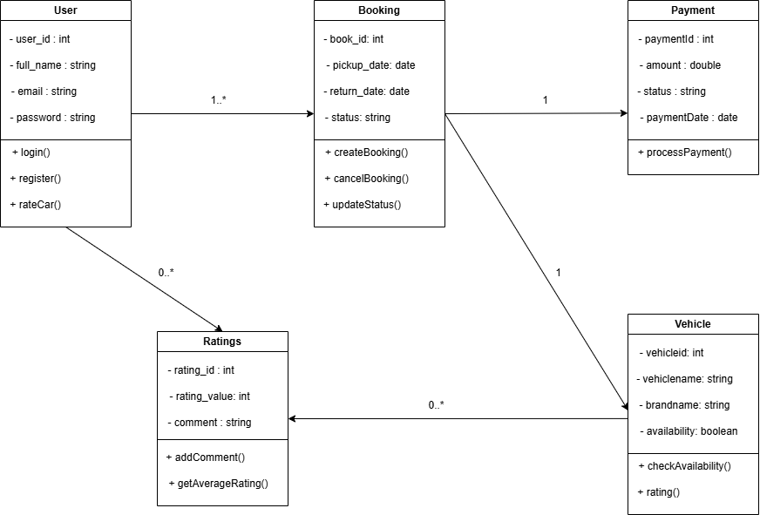
3. HIGH LEVEL DESIGN OF SYSTEM
Class Diagram

Slide 10
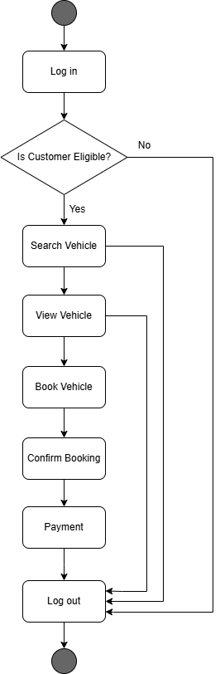
State Diagram

Slide 11
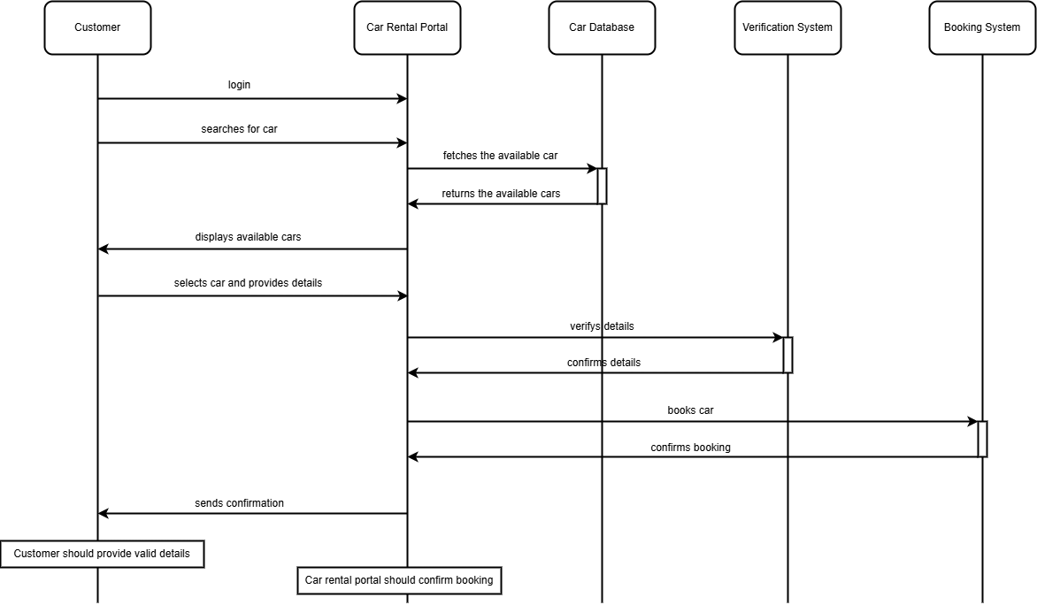
Sequence Diagram

Slide 12
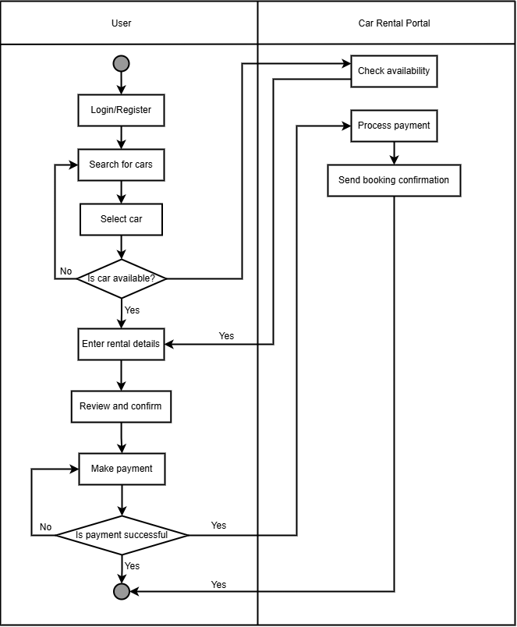
Activity Diagram

Slide 13
Algorithm Details
Rating Algorithm
The Car Rental Portal makes the use of Rating Algorithm (RA) for vehicle recommendation. Rating is a technique that uses to rank the vehicle in the proposed system. This technique is used in to show the popularity of vehicle among the customers.
Rating Algorithm (RA) shows the most rated vehicle which can be rated by the customer on the scale of five. Customers are given rights to rate vehicle according to their choice, and then every time different customers choose to rate a vehicle and then average rating is generated and shown in the vehicle.

Slide 14
Algorithm Details
Payment Algorithm
The Payment Algorithm (PA) in the Car Rental Portal manages each step of the payment process, from calculating the total rental cost to verifying payments. The algorithm factors in several key variables to determine the final amount, such as rental duration, vehicle type, applicable discounts, additional fees (like insurance or late return charges), and tax. It ensures that payments are handled securely, with accuracy and efficiency.

Slide 15
Algorithm Details
Searching Algorithm
The Searching Algorithm (SA) enables users to search for vehicles based on factors such as vehicle name, location, availability, vehicle type, price range, customer ratings, and additional preferences (e.g., fuel type, transmission type). The algorithm processes these inputs and ranks the results based on relevance, allowing customers to find the most suitable vehicle with minimal effort.

Slide 16
Methodology of System
Waterfall Model
sequential development process that flows like a waterfall through all phases of a project (for example analysis, design, development, and testing), with each phase completely wrapping up before the next phase begins.
Simple and easy to understand and use

Slide 17
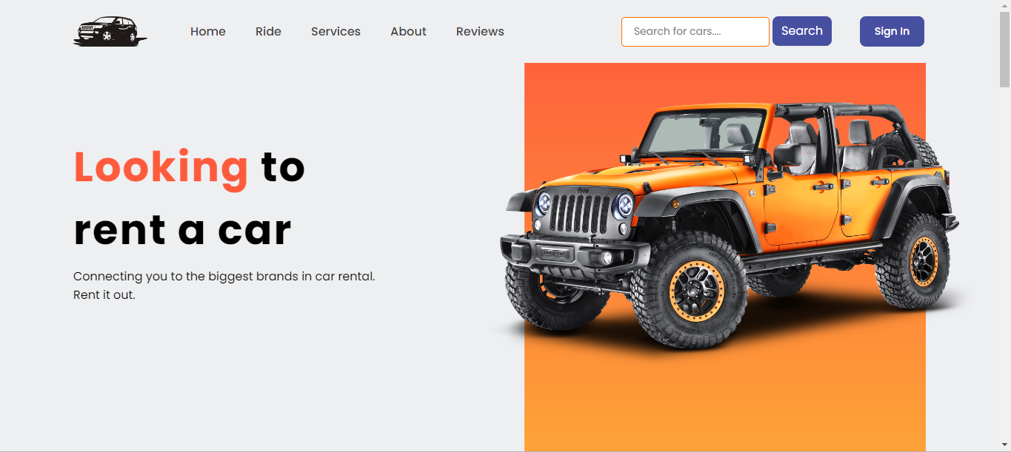
Home page

Slide 18
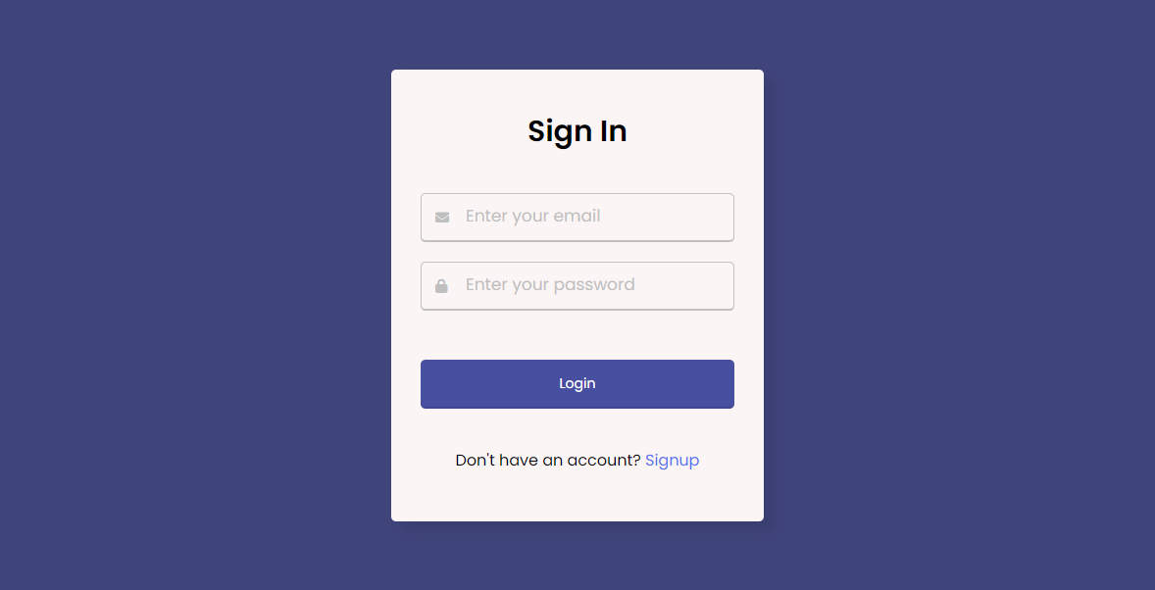
Signin page

Slide 19
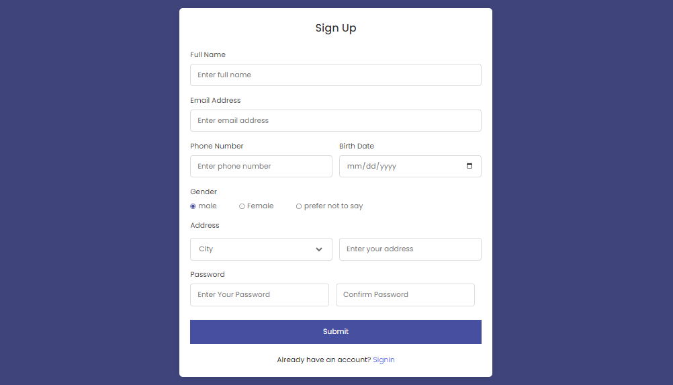
Signup page

Slide 20
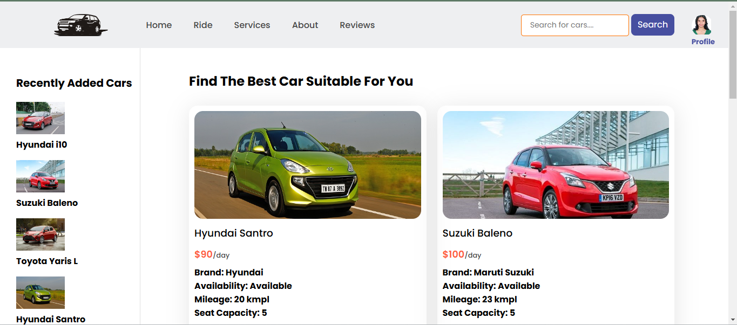
Service page

Slide 21
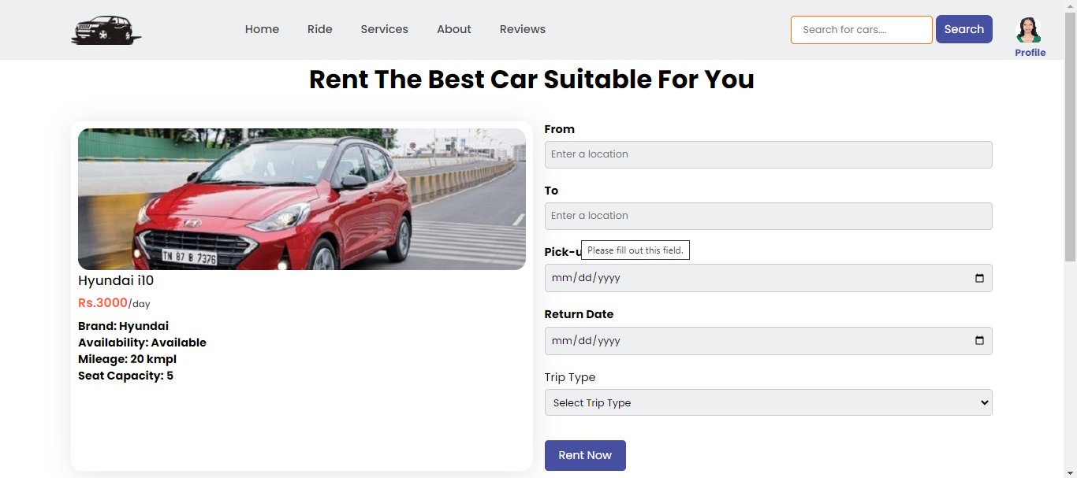
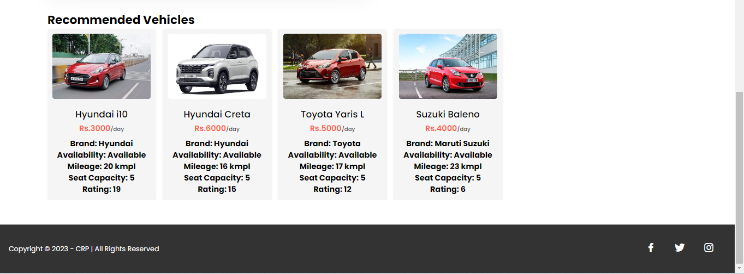
Rent page

Slide 22
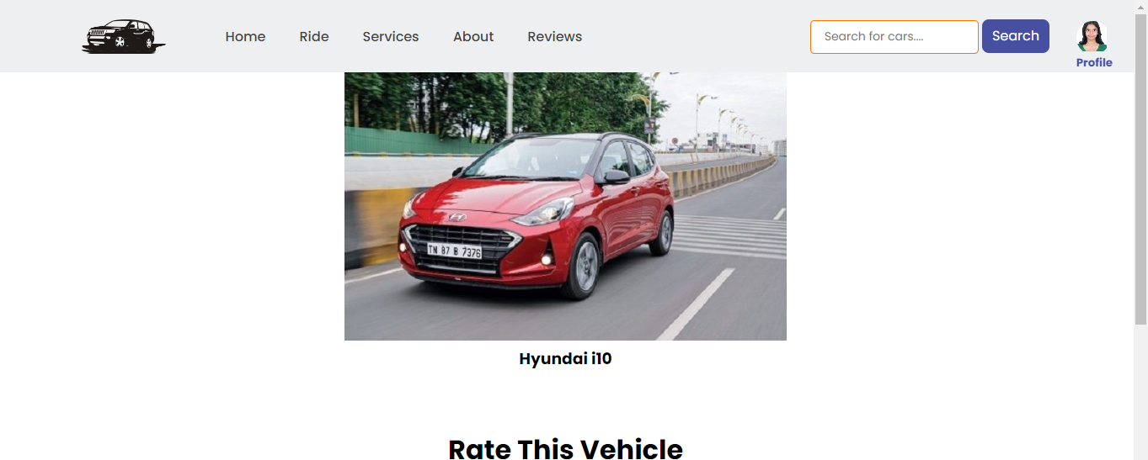

Rate page

Slide 23
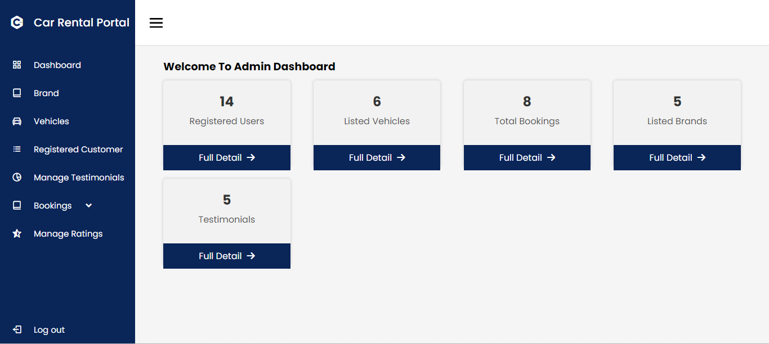
Admin dashboard Page

Slide 24
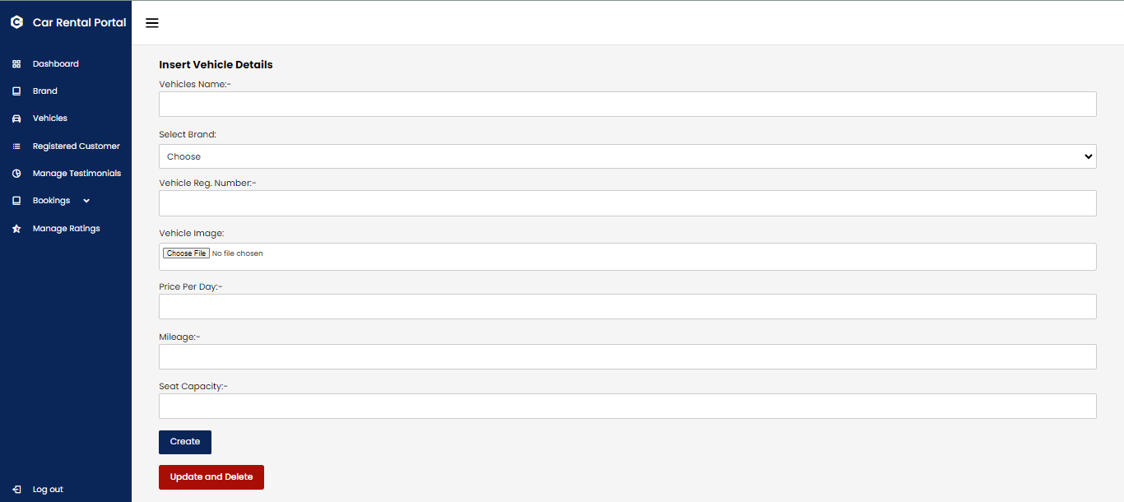
Manage vehicle page

Slide 25
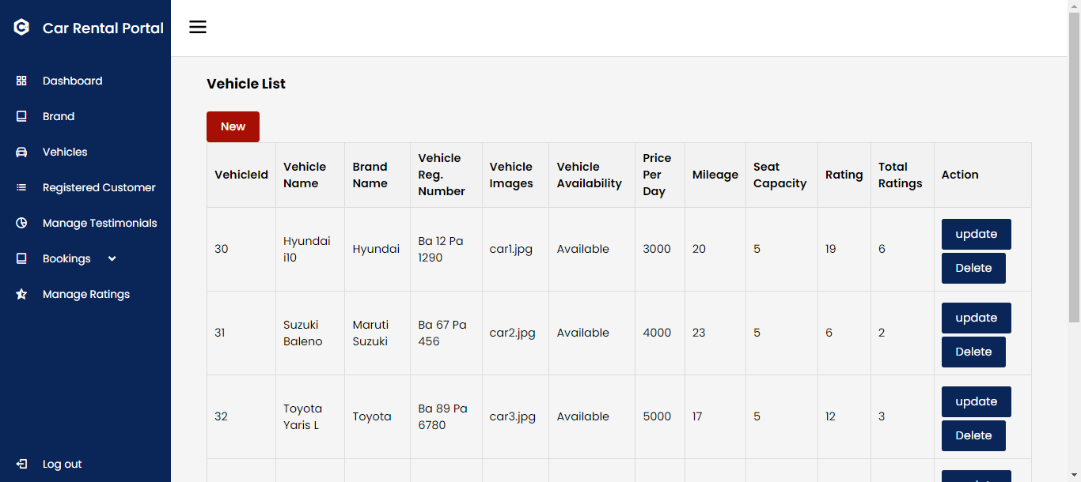

Slide 26
Conclusion
A car rental portal will provide a convenient and efficient way for users to book vehicles for their travel needs.
The portal will be user-friendly that allows users to easily search for available vehicles, make bookings, and share their rental experience.

Slide 27
References
Somerville, Software Engineering, 10th ed. London: Pearson Education Limited, 2016.
Silberschatz, H. Korth and S. Sudarshan, DATABASE SYSTEM CONCEPTS, 6th ed. New York: McGraw-Hill, 2011, pp. 39-55, 259-321.
P. Deitel and H. Deitel, Internet & WorldWideWeb HOW TO PROGRAM, 4th ed. New Jersey: Pearson Education, Inc., 2008.
Draw.io, “Flowchart Maker & Online Diagram Software,” app.diagrams.net, 2023. https://app.diagrams.net/
Khojnu search. Available at: https://www.khojnu.com/
"Project Report on Car Rental System," [Online]. Available: https://www.freeprojectz.com/project-report/1743.
"Car Rental Management System," [Online]. Available: https://www.researchgate.net/publication/353174644_Car_Rental_System

Slide 28
Thank You!
Any Query?

